Slide 1
Public & Patient Involvement in Research
Dr. Emma Dorris
PPI Ignite Network @ UCD Programme Manager
University College Dublin, Ireland
ppi@ucd.ie

Slide 2
What is the top reason interventions don’t work?

Slide 3
Collaborative approach working with the people that the research affects
In health & social care research, we call this public and patient involvement (PPI)

Slide 4
“…decisions made in the light of an adequate understanding of the issues are likely to be better than decisions made in the absence of such understanding.”
1985 The Public Understanding of Science, The Royal Society

Slide 5
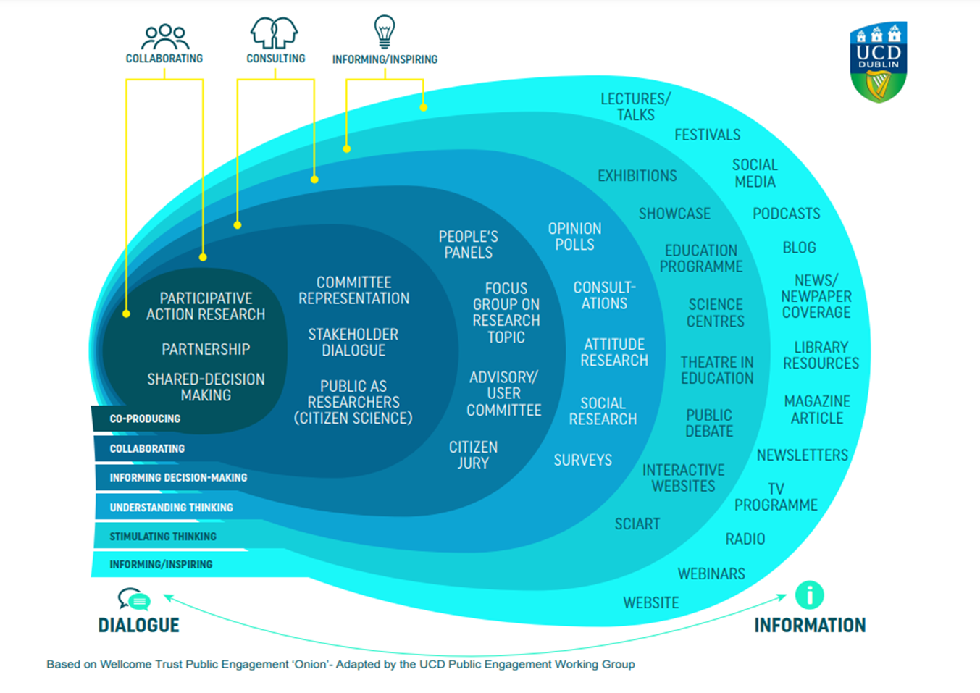
PPI
Public Engagement Spectrum
High
Level of Influence on Research
Low

Slide 6
PPI acknowledges and values the learning, expertise and insight that comes from living with a particular health condition or impairment
PPI is designed to foster collaboration between people with lived experiences, researchers, and research institutions
The goal of PPI is to improve research & increase the ability of research to make a positive impact.

Slide 7
Hallmarks of Research Involvement
Two-way Dialogue
Both parties engage in two-way knowledge exchange and are willing to make changes
Mutually beneficial
All involved should garner benefit from the working relationship, which should be based on fairness and shared power.
Shared decision making
At a minimum, the engaged community should either inform or directly have a level of decision making throughout the research project
Active Roles
Those engaged have an active role in the research. They are not simply passive recipients of knowledge

Slide 8
Involvement or not?
If you seek the views and experiences of patients as data, it is not involvement
Patients involved as partners in research are asked to bring their views and experiences to the table not as data but to contribute to decisions about design, conduct, and reporting of research.
**Clear distinction between patients as data providers and patients as active partners**

Slide 9
Where do research ideas come from?

Slide 10
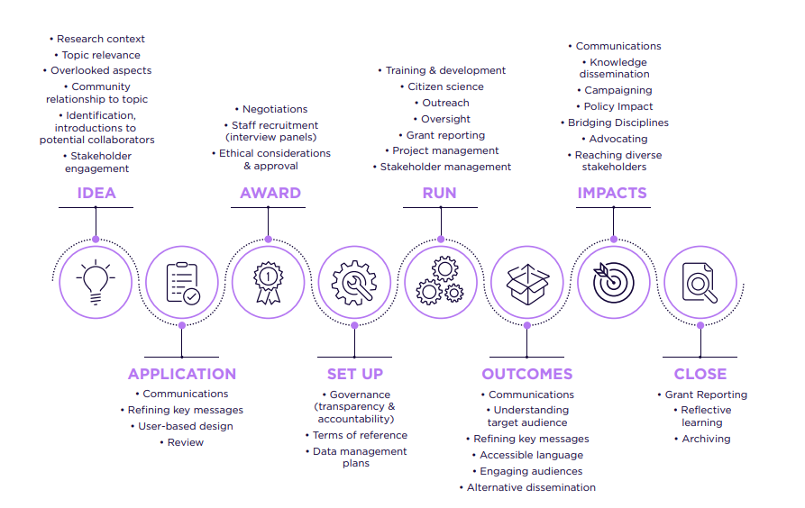

Slide 11
Example

Slide 12
A Different Approach
Full co-creation with patients
Shared Decision making
Shared responsibility for research success /failure

Slide 13
Co-Creation
Co-Design
Brainstorm Concept
N=2
Design Project
N=20
Validate Design
N=156
Fibromyalgia Patient Involvement in Project Design

Slide 14
Patient Participation in Study
Approach resulted in high participation and response rate from fibromyalgia study participants
No participants were recruited via clinic (by design).
289
Male
n=20 (7%)
Female
n= 266 (92%)
Trans Man
n= 2 (1%)

Slide 15
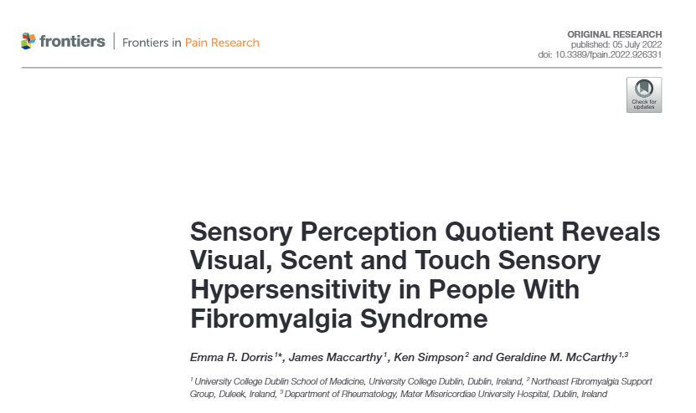

Slide 18
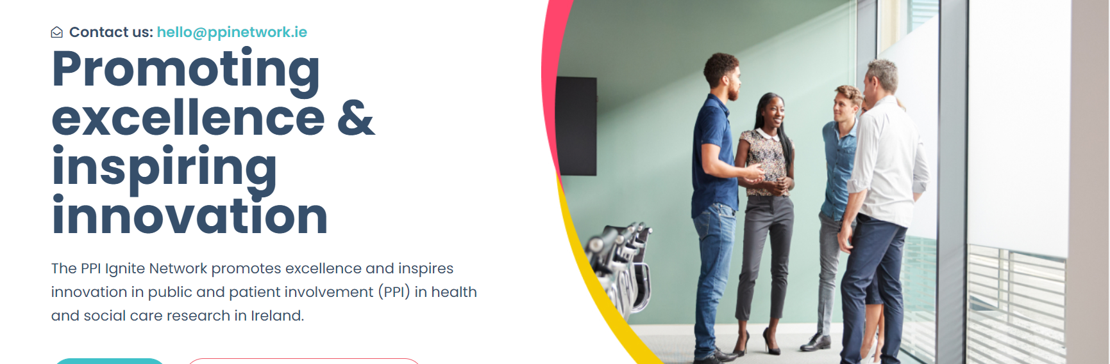
www.ppinetwork.ie

Slide 19
PPI Ignite Network – who we are
National Office

Slide 20
National partners
National Office

Slide 22
Work Streams
Building national PPI capacity across communities
1
Embedding PPI Scholarship into Postgraduate and Undergraduate education
2
Embedding PPI locally and nationally
3
Promoting PPI Excellence
4
Building a strong National PPI Network
5

Slide 23
ppinetwork.ie

Slide 24
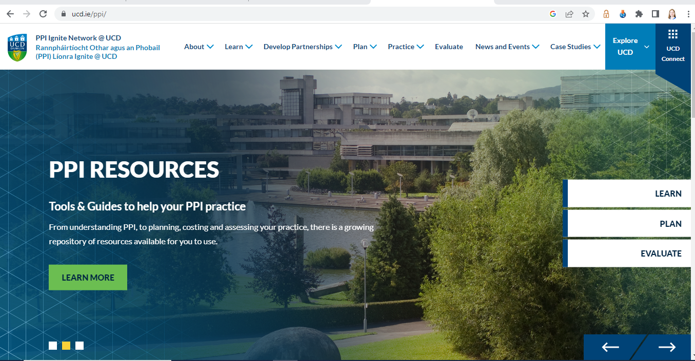
www.ucd.ie/ppi/

Slide 25
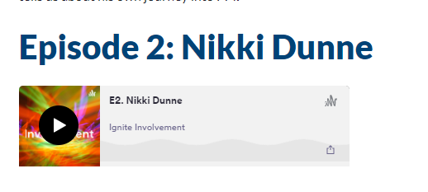
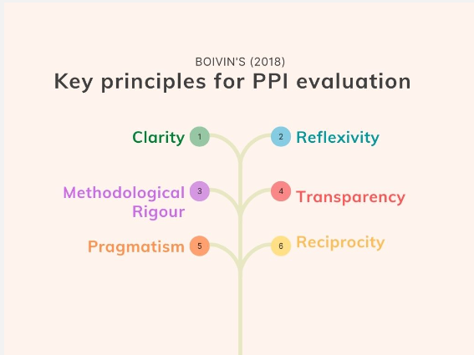
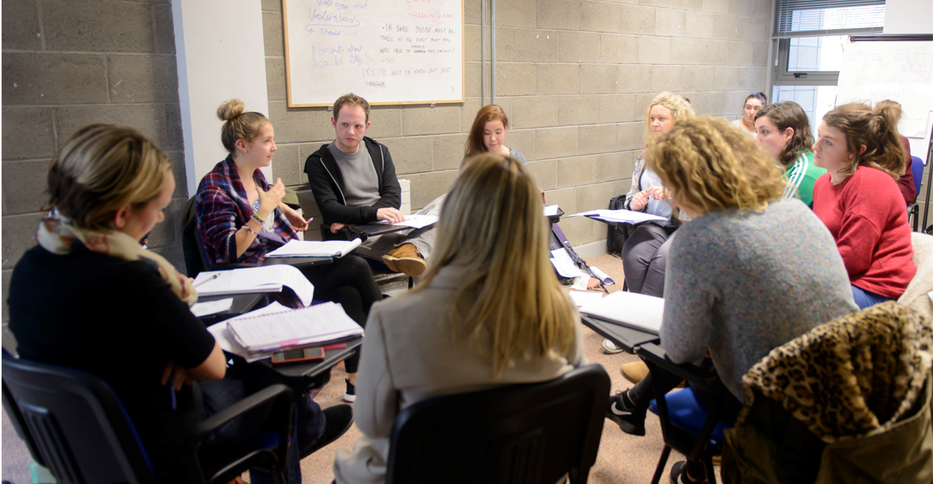

Slide 27
Final Points
Create Touchpoints
Feedback, Follow-through & Frequency
Simple rule: If you wouldn’t ask it of a Professional colleague, don’t ask it of your public partner

