Slide 1

2
Decision making
Second of three training sessions on the Assisted decision-making capacity act 2015
Notes:
The emphasis of this first of three sessions is on an exploration of “decision making” and introduces the functional steps of decision making in easy to understand language.
Set up a flipchart with “choices” on one side of a page and “decisions” on the other side.
Have a template of the UN Convention at each place. Have the Paddles of Information, Remember, Think About and Communicate at hand. Have the decision cards at hand and use throughout the training to encourage conversation and interaction.
Begin with an icebreaker for the group to get to know one another.

Slide 2

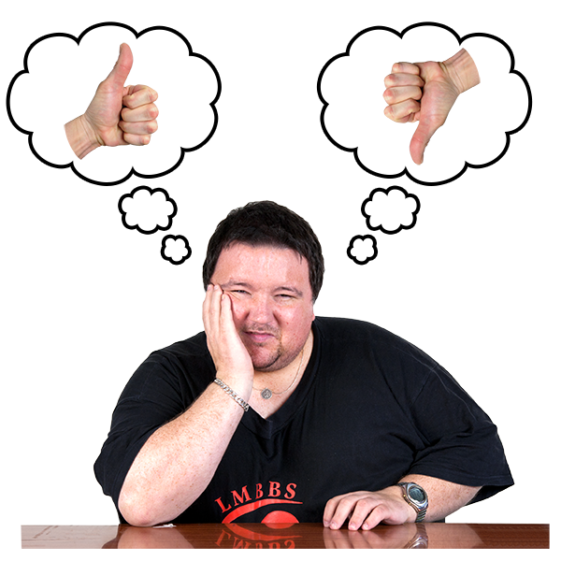
Decision making
Notes:
Begin with the flipchart from the last session on decisions. Listen closely to what people remember from the previous session. Circulate the decision cards and invite one or two people, if appropriate, to use the paddles to go through the steps of decision making.

Slide 3

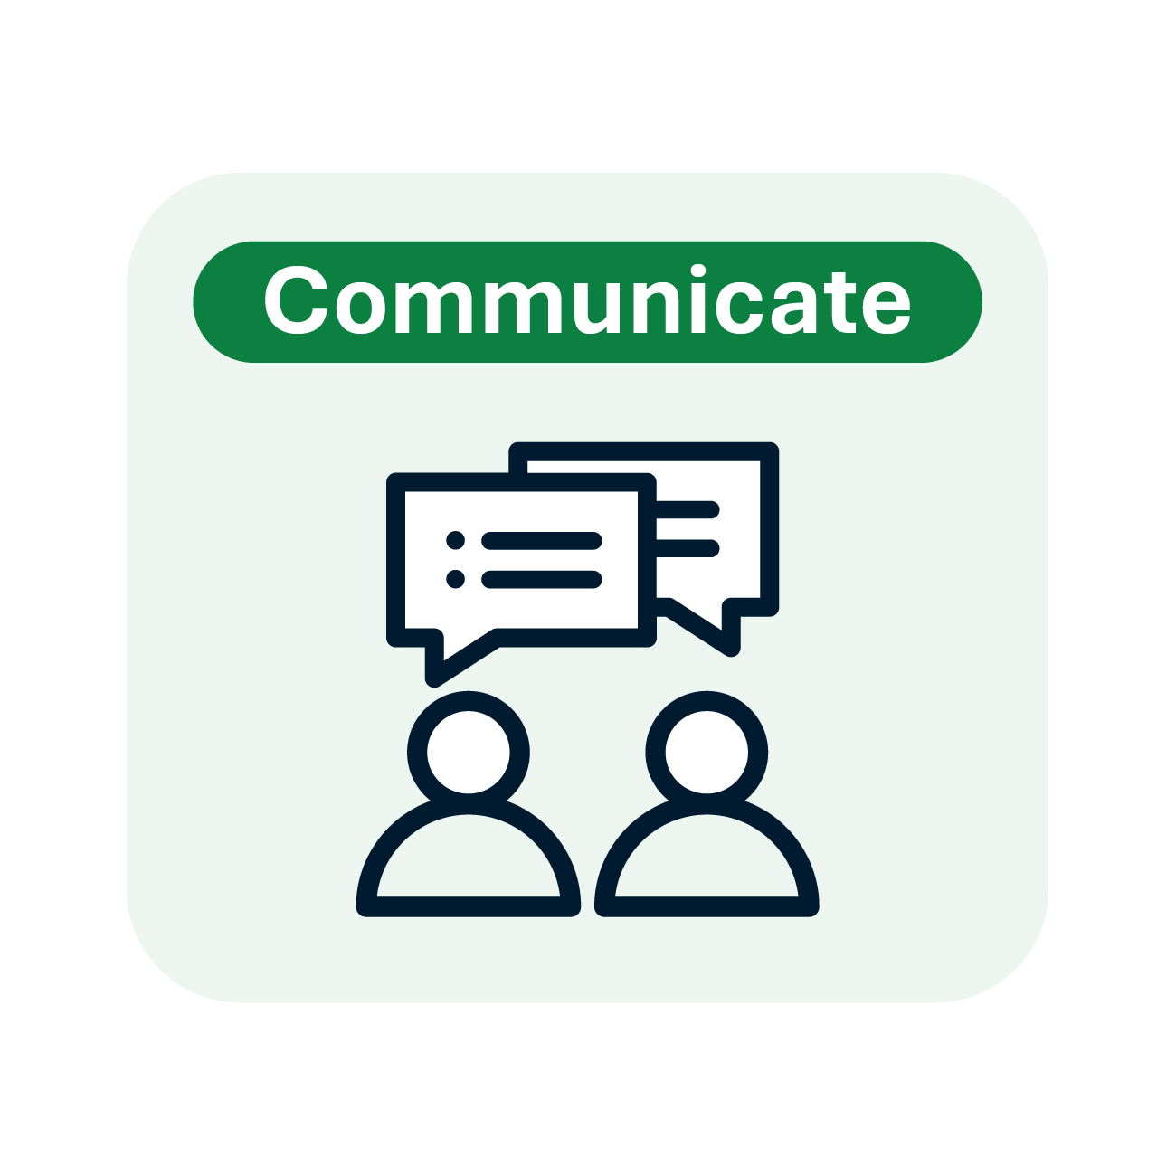
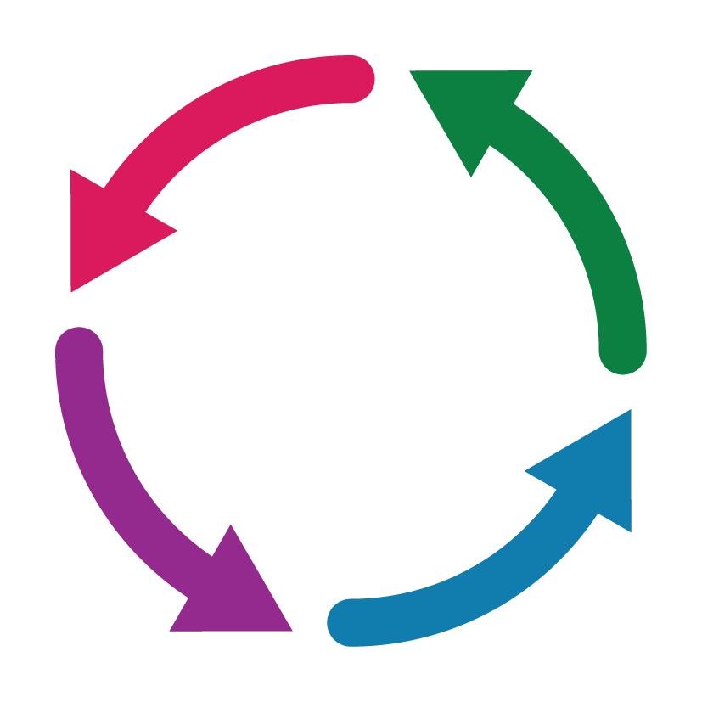


Decision making
Notes:
Template on decision making, pull together all of the aspects of decision making and explain the process of the arrows in a circular motion as describing a process.

Slide 4
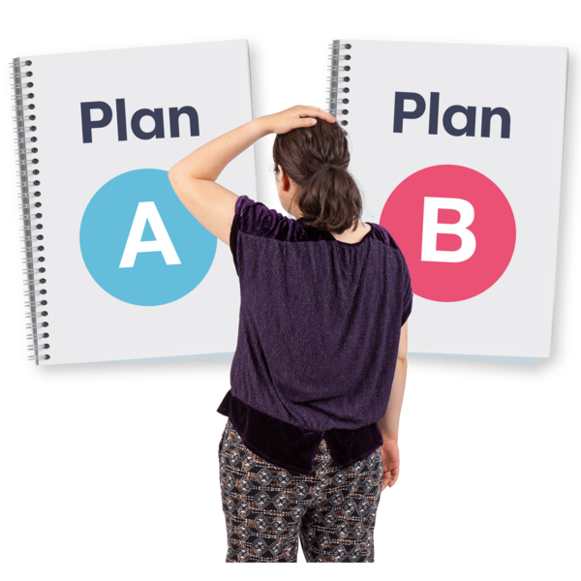
How many decisions/choices do we make in one day?
300 (some)
3,000 (many)
35,000 (lots)
Notes:
The purpose of this slide is to point out how we are constantly making choices and decisions in our lives… use hands in a horizontal movement to visualise some, many, and hands wide apart as lots. Between choices and decisions we make 35,000 in one day. Looking at decision making is important. We do not need support for all 35,000! Imagine! Yet, for some we may need support. Knowing when to ask for support is important. Knowing that there is a law that has given this some thought can be helpful.

Slide 5
Margaret, a decision support service champion
https://www.youtube.com/watch?v=cZGLtGXJjR0
Notes:
Before we learn more about the Assisted Decision Making Law and the Decision Support Service I would like to introduce you to some of the Decision Support Service Champions. There are nine individuals who are Champions. The people who feature in these two minute videos have an intellectual disability. They share why the Decision Support Service is important in their lives. Let us look at the story of Margaret.

Slide 6
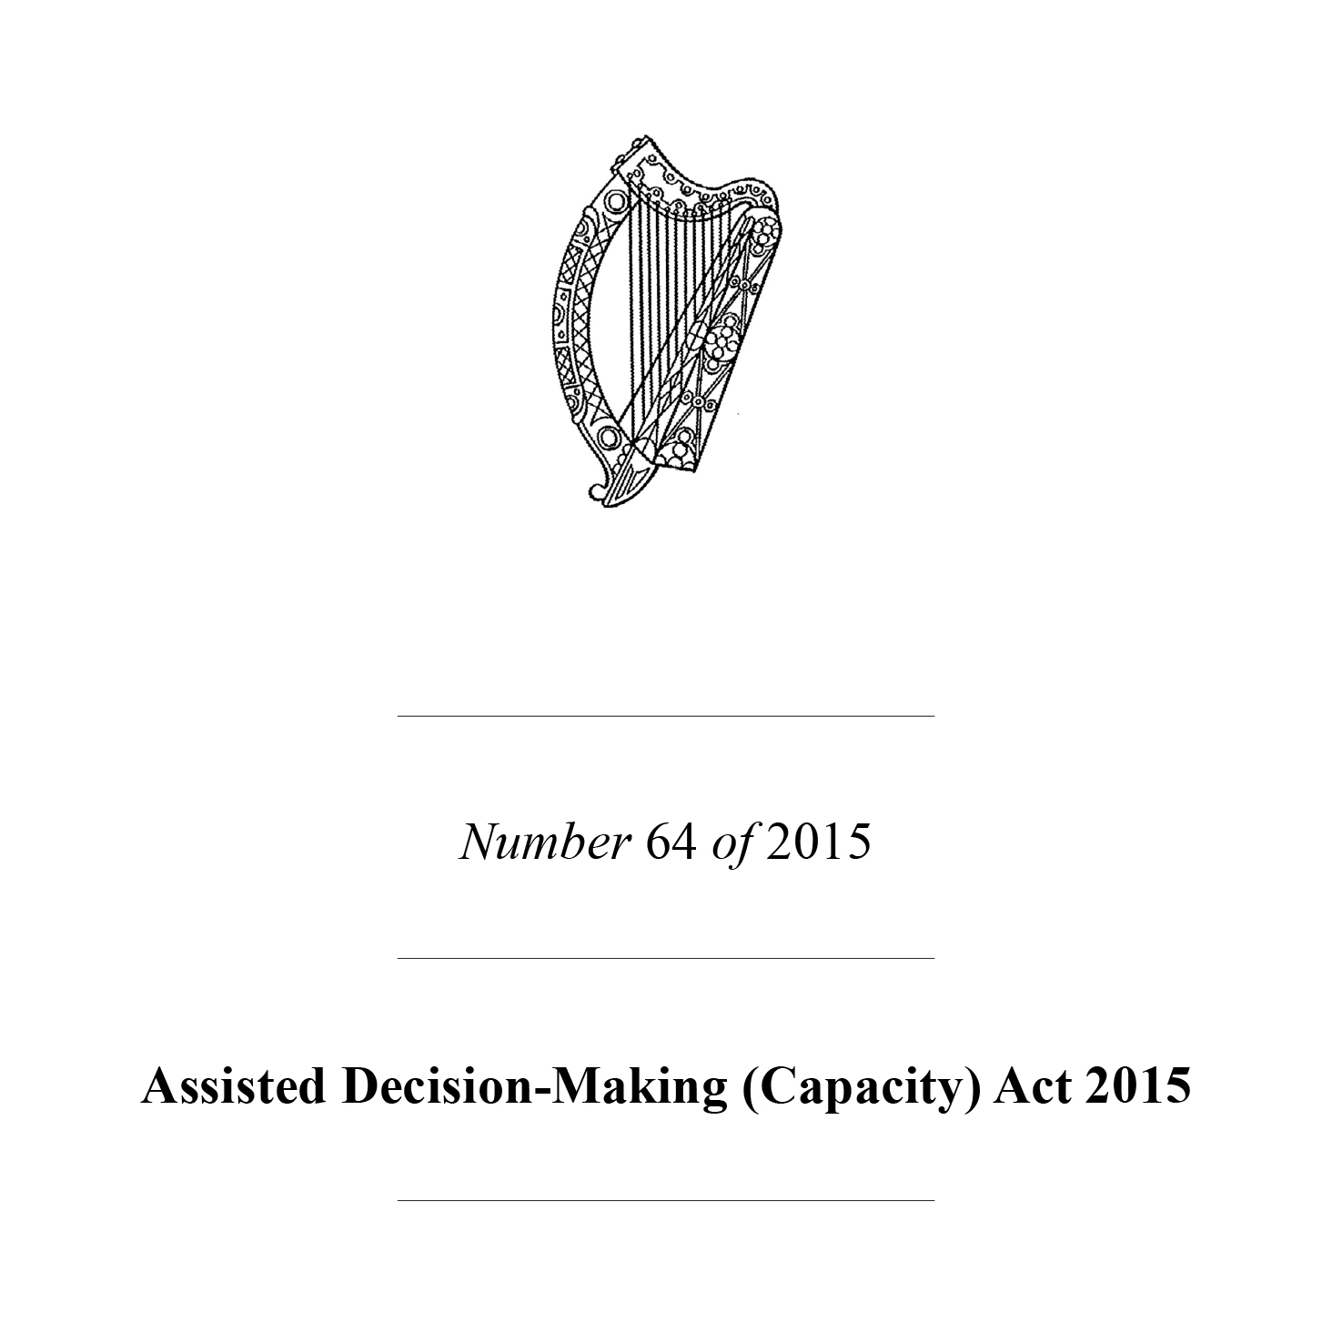
Assisted Decision Making Capacity Act 2015 became Law in April 2023
Notes:
What is law? A law is a set of rules created by government to guide behaviour. Why is law important? The law is created to protect and to support people.
The Act became a Law in April 2023.
This law has many names.
The ADM
2015 Act
Assisted Decision Making Act
Capacity Act

Slide 7
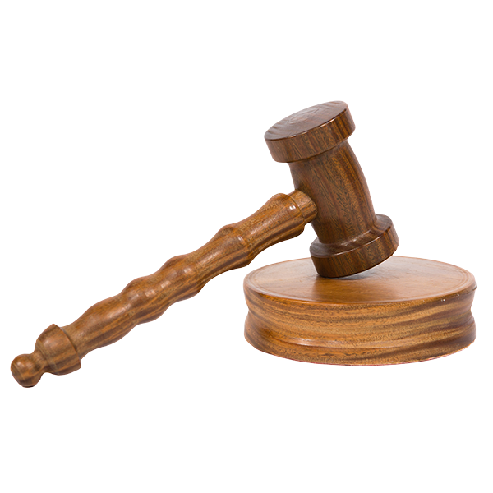
Assisted Decision Making Capacity Law 2015
Nine main beliefs about supporting a person who may need support with their decision-making capacity
Created decision supporter roles
Ended the wardship system
Established the Decision Support Service
Notes:
What does the Assisted Decision Making Capacity Law 2015 do for people?
It created nine guiding principles or nine main beliefs that provide the foundation or building blocks for the Assisted Decision Making Capacity Law
It created decision supporter roles
It ended the wardship system
It established the Decision Support Service

Slide 8
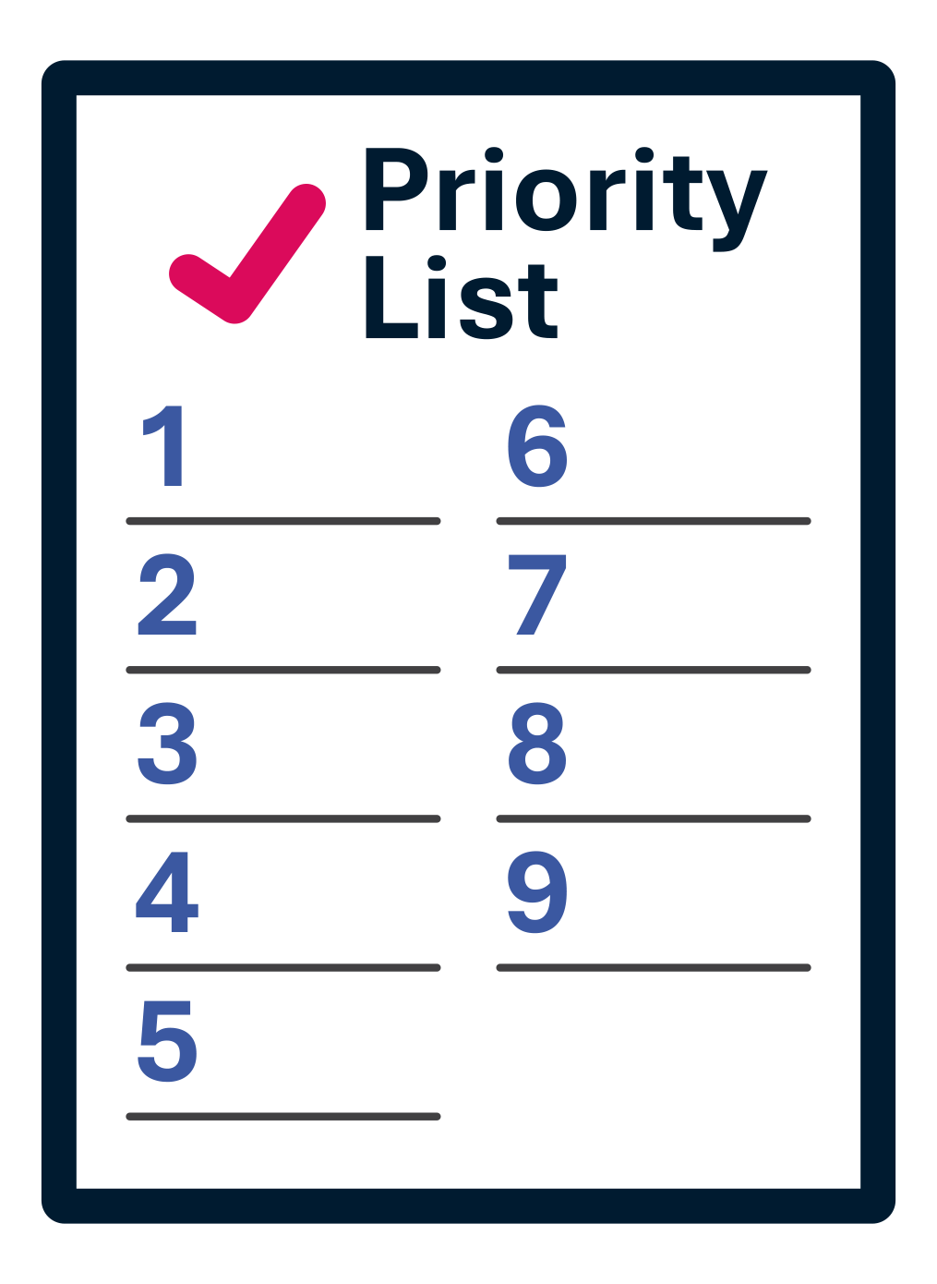
Nine Main Beliefs
of the Assisted Decision Making Law
Notes:
What are the nine main beliefs behind the Assisted Decision Making Law? These beliefs remind us of the importance of the law to help to protect rights and to support the rights of all people.

Slide 9
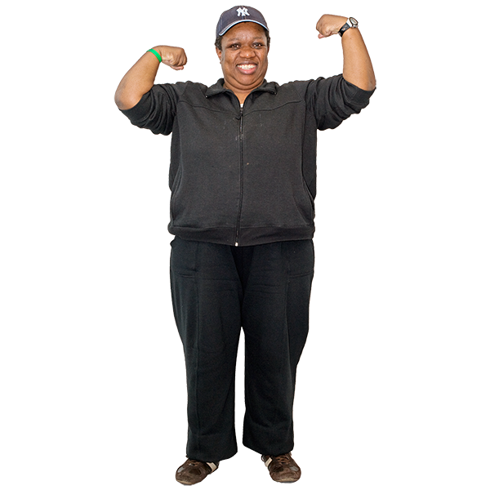
I have capacity to make decisions about my own life
Notes:
Each person has a right to make his/her own decisions. What is capacity? Capacity is that a person has the ability to use and to understand information. Capacity means that a person can make and communicate a decision. Capacity means that a person can follow the steps of decision making. If a person has others in their lives that support them in decision making this can be part of his/her capacity.

Slide 10
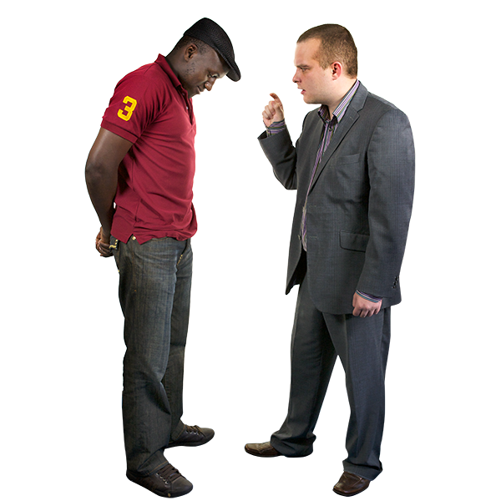
I have the right to get as much support as I need to make my own decision(s)
Notes:
A person has the right to get as much support as needed to make a decision. Most often this will be people close to you or your natural supports. You may have someone in your life that helps you with day to day decisions. You may have someone else who supports you with bigger decisions. This can be many people or a group. It may be family or friends. These supports do not need to change. You may wish to register these supports with the Decision Support Service, but there is no need if the supports are working for you at present. For people without supports they can register through the Decision Support Service to make an arrangement. A person who works for a disability service cannot be a registered support person.

Slide 11
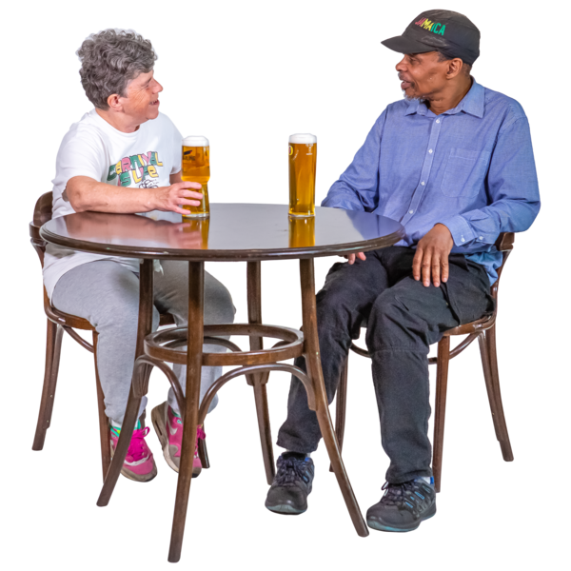
My capacity to make a decision should not be questioned if I make what another person may consider to be an unwise decision.
Notes:
A person, like any other, has the right to make what others may consider to be an unwise decision. Everyone makes decisions that others may not agree with. This does not mean that an individual does not have the ability to make decisions or that a person does not have capacity. If I have made a decision that may hurt myself or others it would be natural that people support me to look at my decision.

Slide 12
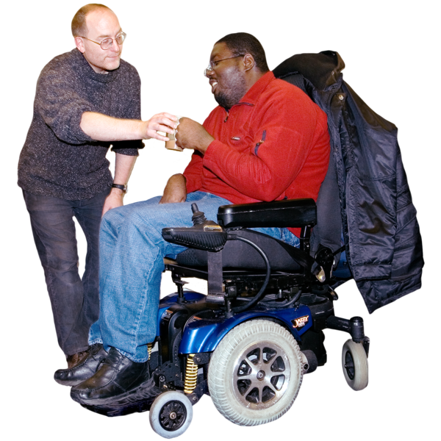
I only need support or someone to take action when it is really necessary
Notes:
Everyone has a right to make a decision. Even if a person cannot make a decision about one thing it does not mean that they cannot make a decision about another thing. It is the right of the individual to seek support when they are ready.

Slide 13
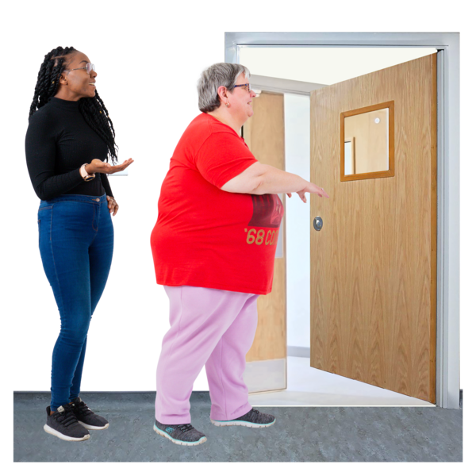


If I need support it should be just the amount I need and the support should not limit or control my rights and freedoms
Notes:
Others may think that I do not have the capacity or ability to make a decision. I have the right to seek the amount of support that I need. This support should give me freedom to think through my decision. This support should respect my will and preference.

Slide 14
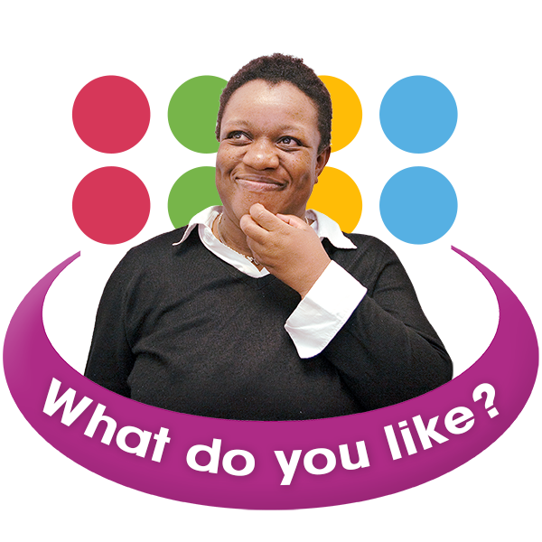
It is my will and preference that is important in the decision making
Notes:
A person’s will is about what they value, what they think is important. It may be connected to what one believes and what goals a person may have. A person’s preferences means a greater liking for one choice over another. Preference is about the things that interest you the most.

Slide 15

If needed, I will have you speak to others who know me well to help with the decision making
Notes:
As the person making the decision you are in the driving seat. You may direct people to people in your life to support decision making.

Slide 16
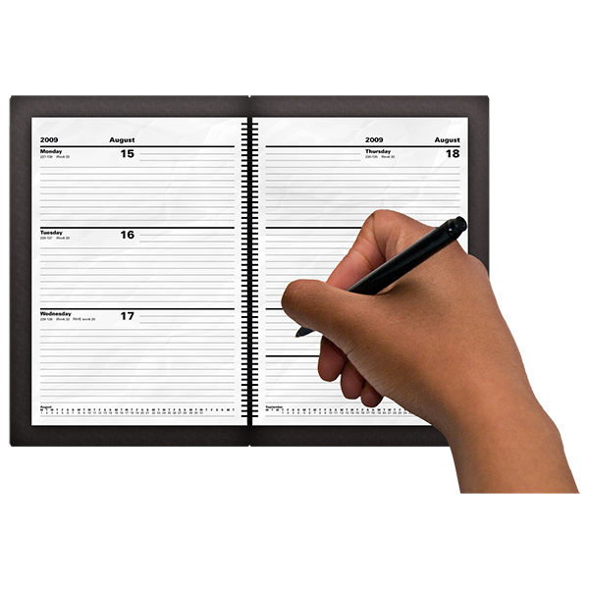
I will consider how quickly the decision needs to be made and what action is needed
Notes:
The decision maker is the one to map out the timing of the decision to be made. Keeping a record online or in writing can be useful.

Slide 17
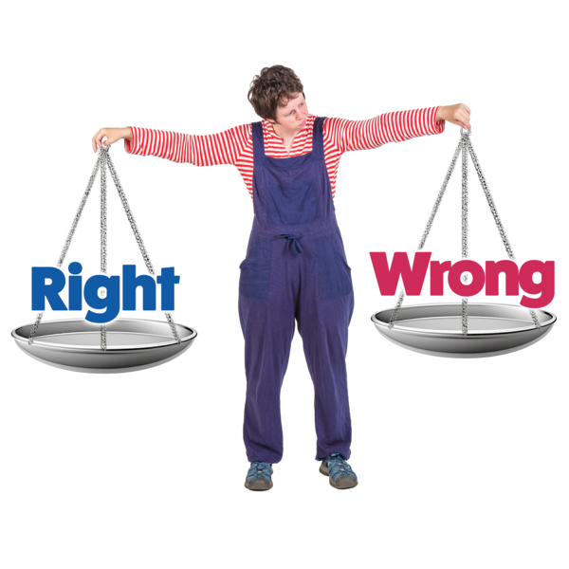
I will use information in the right way, with respect for the law, keeping private what needs to be, and in a way that harms no one
Notes:
In adult decision making there is a right and a wrong way to use information. There is a need for keeping information private. There is a need to share information if needed, too.

Slide 18
Fionn, a decision support service champion
https://www.youtube.com/watch?v=aG5kOFE6tys
Notes:
Let us hear from our next Decision Support Champion, Fionn

Slide 19
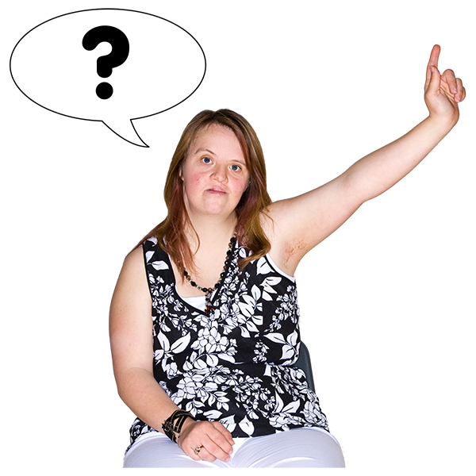
Questions

Slide 20
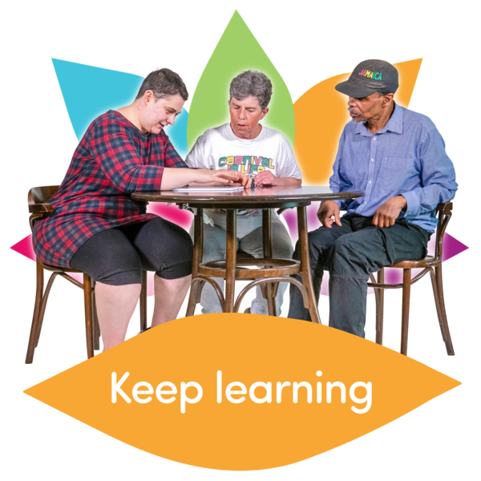
What did I learn today?
Notes:
Review the Nine Main Beliefs

Slide 21

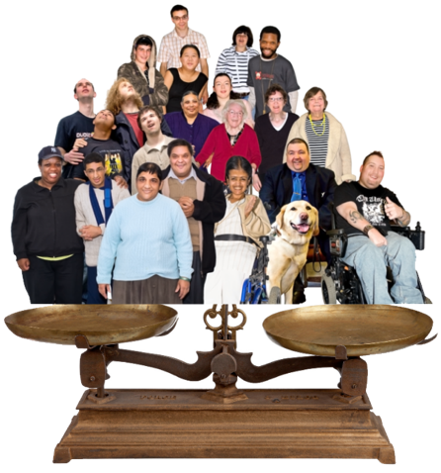
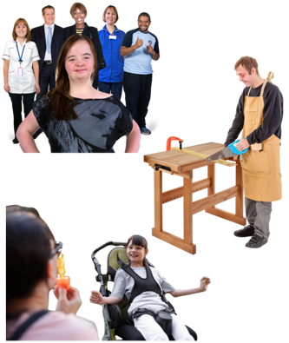
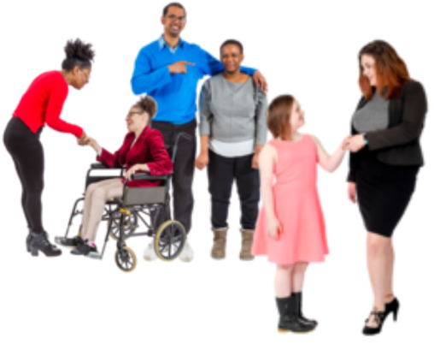
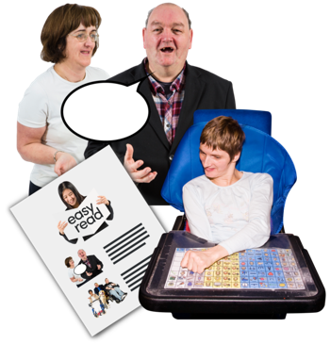
Our values
Respect
Inclusion
Equality
Voice
Choice

Slide 22



Our goals
Campaign
Support
Leaders
We are a campaigning organisation working for real change in people’s lives
We support people with intellectual disabilities to be valued and effectively participate in society
We are leaders in accessible information and communication

Slide 23

For our next session we will learn about the Decision
Support Service (DSS)
Notes:
Set up the projector with the PowerPoint. Set up the room in circular or rectangular seating around tables. Put up the flipchart with the decision making information gathered at the last session. Distribute the materials as in the last session with each participant having a set of decision making paddles, a decision making chart, and an UNCRPD chart.

Slide 24







